Slide 1
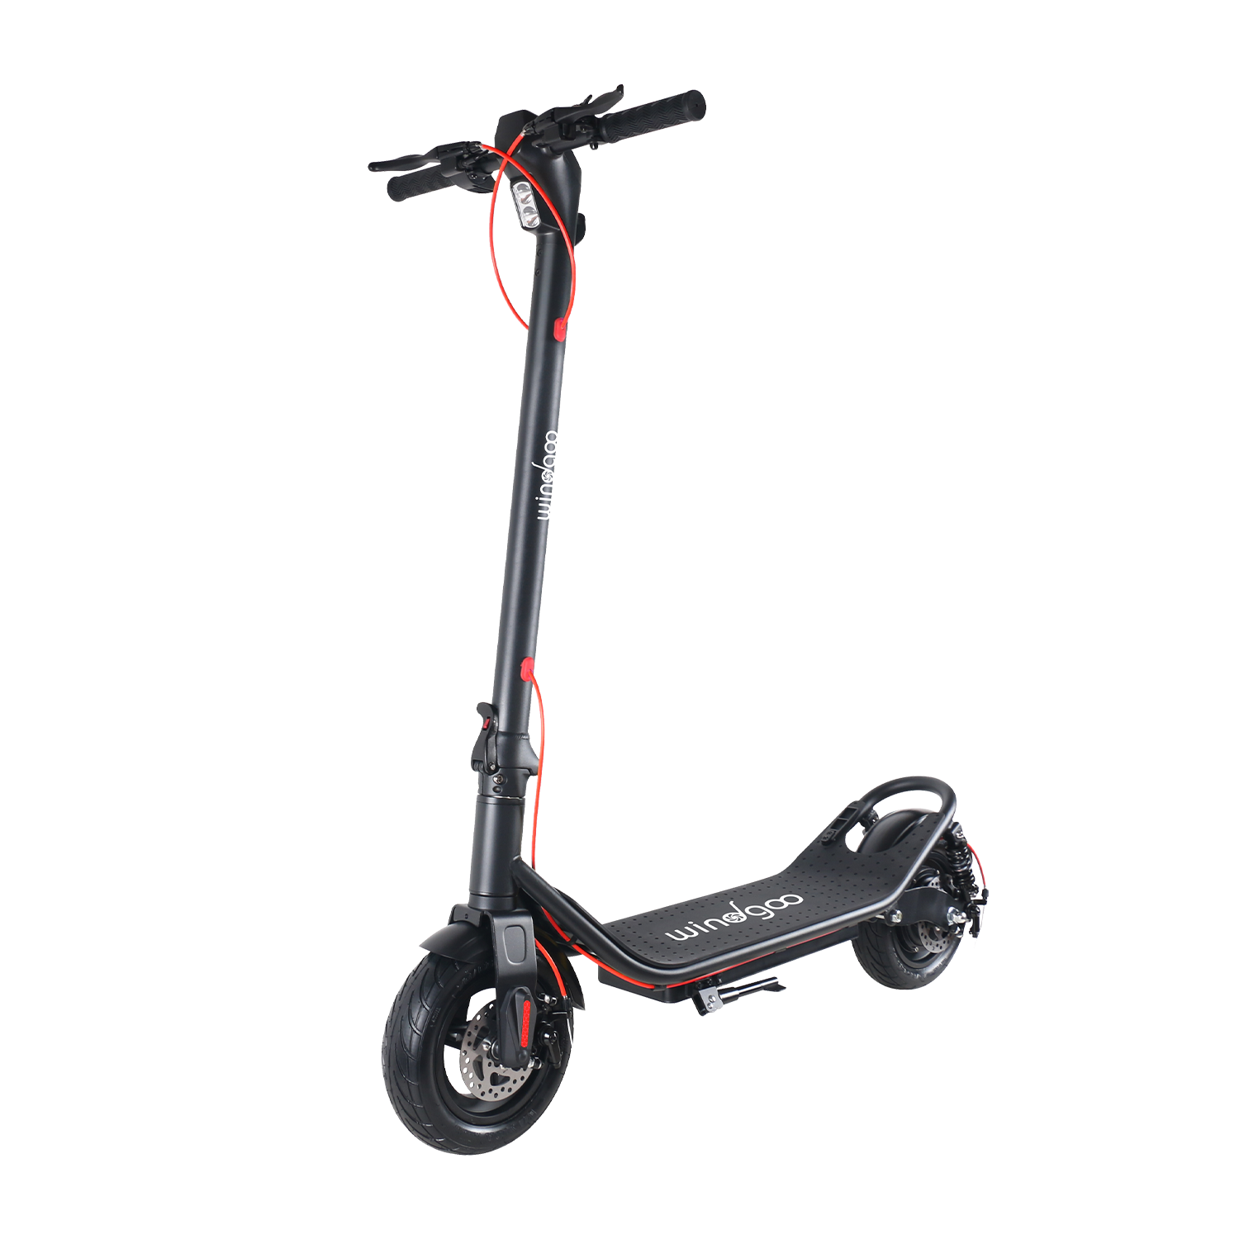
Electric scooter
A new and already deprecated way to move.

Slide 2
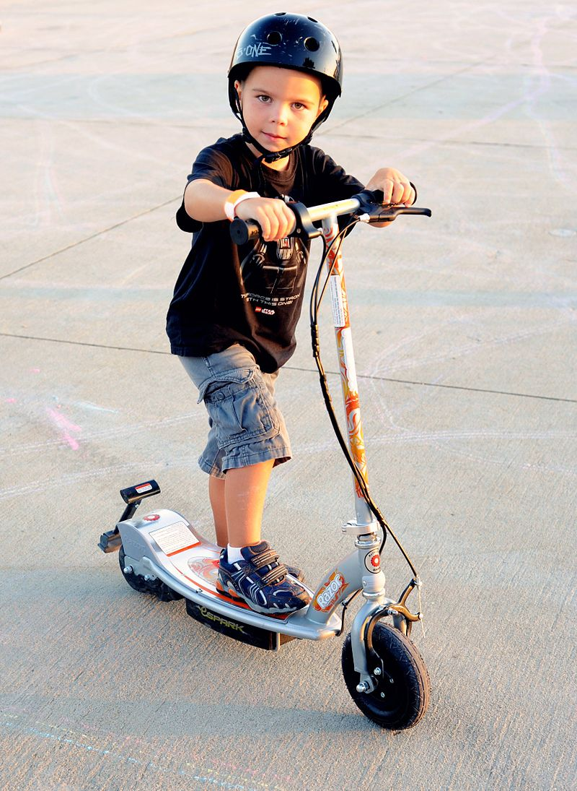
What’s the purpose?
Battery life and range
Speed and safety features
Design and durability

Slide 3
Specifications :
Efficient urban transportation
Reducing carbon footprint
Accessibility and convenience

Slide 4
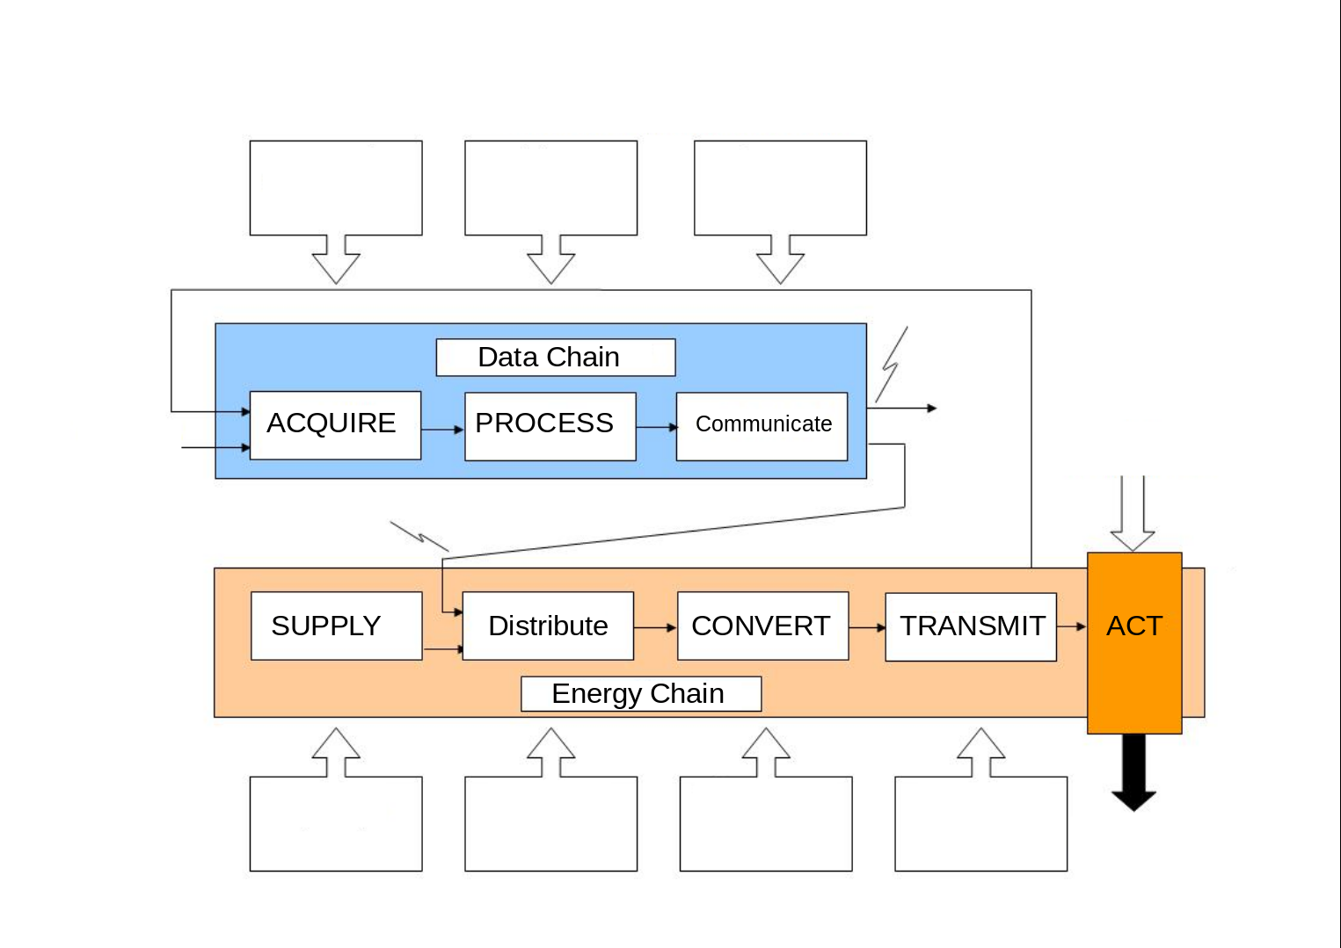
Throttle & captors
CPU
Screen
Lithium Battery
Powerbo-ard
Electric Motor
Transmi-ssion Belt

Slide 5
Opinion & conclusion
Pros and cons
Future potential and challenges
Personal viewpoint on sustainability

